Slide 1
Advanced Reports
Microsoft Access 2013
Lesson 11

Slide 2
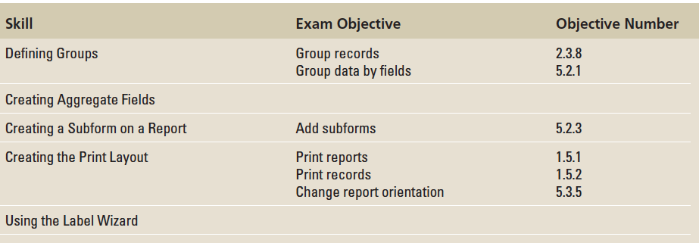
Objectives

Slide 3
Step by Step: Use the Report Wizard
GET READY. Before you begin these steps, be sure to turn on and/or log on to your computer and LAUNCH Access.
OPEN Messenger from the data files for this lesson.
SAVE the database as MessengerXXX (where XXX is your initials).
Open the Corporate Sales table.
On the CREATE tab, in the Reports group, click the Report Wizard button. The first Report Wizard dialog box appears.
Select the Region (Borough) field and click the . button to move the field to the Selected Fields list.

Slide 4
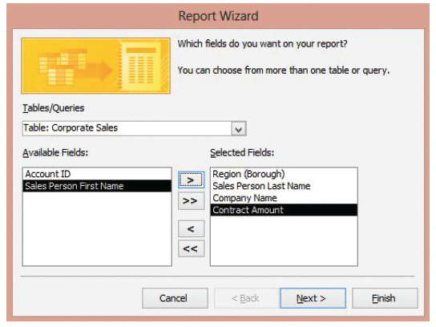
Step by Step: Use the Report Wizard
Using the same method, move the Sales Person Last Name, Company Name, and Contract Amount fields from the Available Fields list to the Selected Fields list, as shown at right.

Slide 5
Step by Step: Use the Report Wizard
Click the Next > button. The second Report Wizard dialog box appears.
Select the Region (Borough) field and click the . button to move it to the grouping levels box.
Select the Contract Amount field and click the . button to move it to the grouping levels box.
Select the Sales Person Last Name field and click the . button to move it to the grouping levels box.

Slide 6
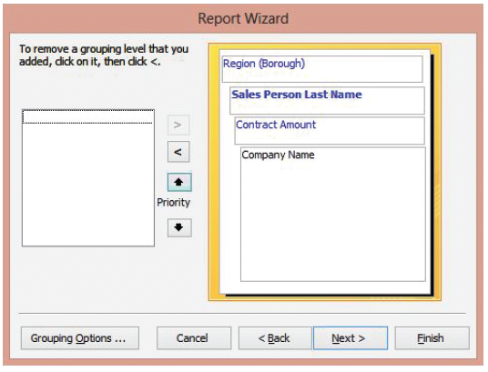
Step by Step: Use the Report Wizard
Notice that the Sales Person Last Name field is the active field in bold type. Click the Priority up arrow to move the Sales Person Last Name field to the second level of grouping. Your screen should look similar to the figure at right.

Slide 7
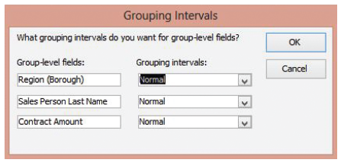
Step by Step: Use the Report Wizard
Click the Grouping Options button at the bottom of the dialog box. The Grouping Intervals dialog box appears, as shown below.
Click the down arrow on the first Grouping intervals menu to see the choices available. Select Normal from the menu and click OK.

Slide 8
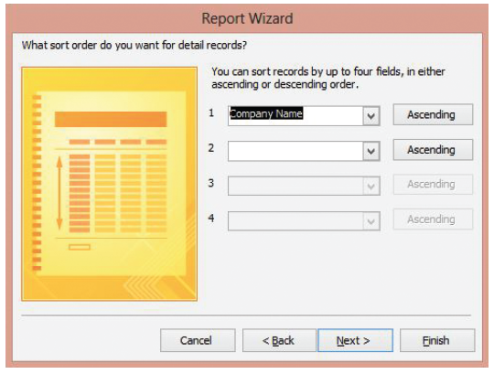
Step by Step: Use the Report Wizard
Click the Next > button. The third Report Wizard dialog box appears. You can sort in either ascending or descending order and by up to four fields.
Click the down arrow on the Sort menu and select Company Name, as shown at right. You will sort in ascending order by Company Name.

Slide 9
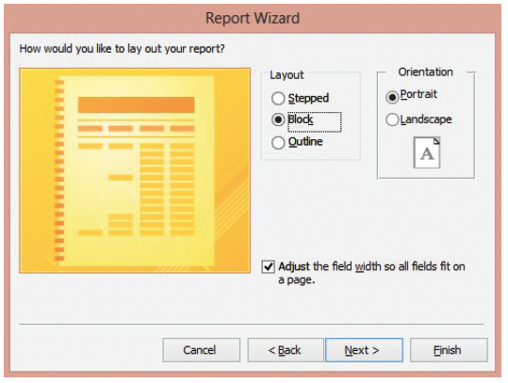
Step by Step: Use the Report Wizard
Click the Next > button. The fourth Report Wizard dialog box appears. You can choose from three different layouts for your report as well as two different orientations.
In the Layout section, click the Block option button, as shown above. Keep the default orientation as Portrait and keep the selection so all fields fit on one page.

Slide 10
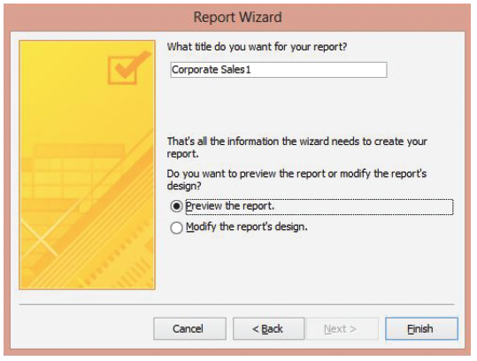
Step by Step: Use the Report Wizard
Click the Next > button. The fifth Report Wizard dialog box appears, as shown at right.
Key Corporate Sales by Region/Salesperson as the title of your Report, replacing the default title of Corporate Sales1.

Slide 11
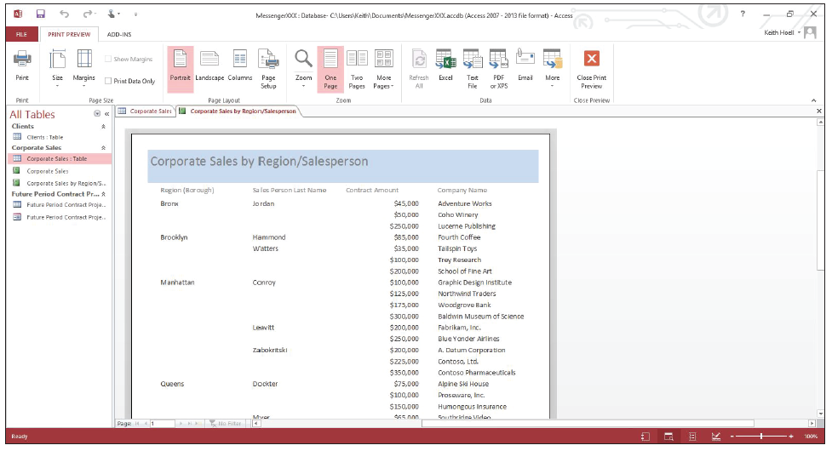
Step by Step: Use the Report Wizard
Click the Finish button to accept the settings. The Report Wizard creates the report, shown below, with the groups you specified.
CLOSE the report and the table.
PAUSE. LEAVE the database open to use in the next exercise.

Slide 12
Step by Step: Use the Group, Sort, and Total Pane
USE the database that is open from the previous exercise.
OPEN the Corporate Sales report. Notice that the report is not arranged by groups.
Switch to Layout view and close the Field List pane if it opens.

Slide 13
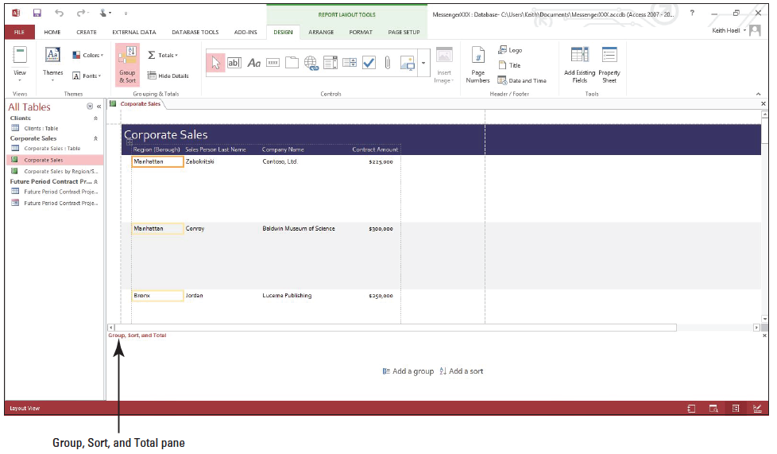
Step by Step: Use the Group, Sort, and Total Pane
On the DESIGN tab, in the Grouping & Totals group, click the Group & Sort button. The Group, Sort, and Total pane appears at the bottom of the screen, as shown below.

Slide 14
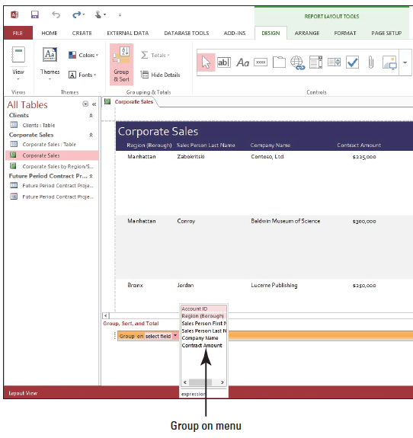
Step by Step: Use the Group, Sort, and Total Pane
Click the Add a group button. Select Region (Borough) from the Group On menu, as shown t right. The report is now grouped on the Region (Borough) field.
Click the Add a group button on the Group, Sort, and Total pane. Select Sales Person Last Name from the Group On menu. The report is now also grouped on the Sales Person Last Name field.
Notes:
Another Way: You can also right-click a field header in Layout view and select Group On Field Name from the shortcut menu to define a group header.

Slide 15
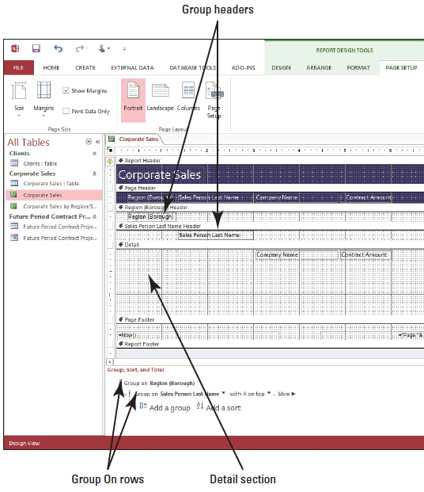
Step by Step: Use the Group, Sort, and Total Pane
Switch to Design view. Your screen should look similar to the figure at right. Notice that there is a Region (Borough) Header for that group and a Sales Person Last Name header for that group. The Company Name and Contract Amount fields are arranged in the Detail section.
SAVE the report.
PAUSE. LEAVE the database open to use in the next exercise.

Slide 16
Step by Step: Change Grouping Options
USE the database and report that is open from the previous exercise.
Switch to Layout view.
Click the Group On Sales Person Last Name row in the Group, Sort, and Total pane and then click the More button to view the available grouping options.

Slide 17
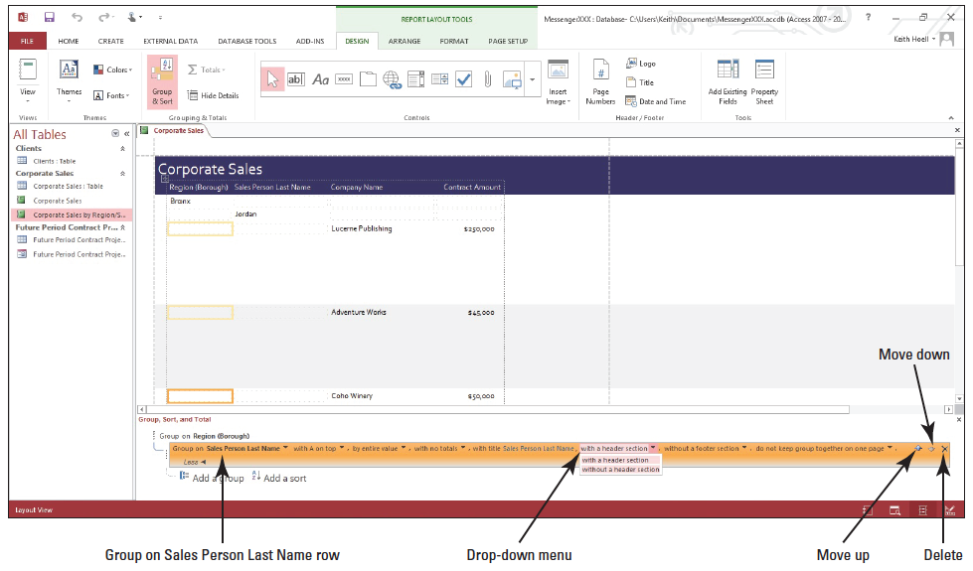
Step by Step: Change Grouping Options
Click the down arrow beside with a header section and select without a header section from the drop-down menu, as shown below.

Slide 18
Step by Step: Change Grouping Options
Switch to Design view. Notice that the Sales Person Last Name Header has been deleted from the grouping area.
Switch to Layout view.
Click the down arrow beside the without a header section (if the without a header section option doesn’t appear, click the More button) and select with a header section from the drop-down menu.
Click the Move up arrow at the end of the Group On Sales Person Last Name row. Notice that the Sales Person Last Name group is now the top level group in the report.

Slide 19
Step by Step: Change Grouping Options
Click the Add a group button and select Company Name from the menu. A new group level is added to the report.
On the DESIGN tab, in the Grouping & Totals group, click the Hide Details button. The data in the Contract Amount field is hidden.
On the DESIGN tab, in the Grouping & Totals group, click the Hide Details button. The data in the Contract Amount field is displayed.
Click the More button in the Group, Sort, and Total pane.

Slide 20
Step by Step: Change Grouping Options
Click the with A on top down arrow on the Group On Company Name row in the Group, Sort, and Total Pane and select with Z on top from the drop-down menu. The sort order is changed from ascending to descending order.
Click the with Z on top down arrow and select with A on top.
Click the Delete button on the right side of the Group On Company Name row in the Group, Sort, and Total pane. The row is deleted, as is the Company Name header section.

Slide 21
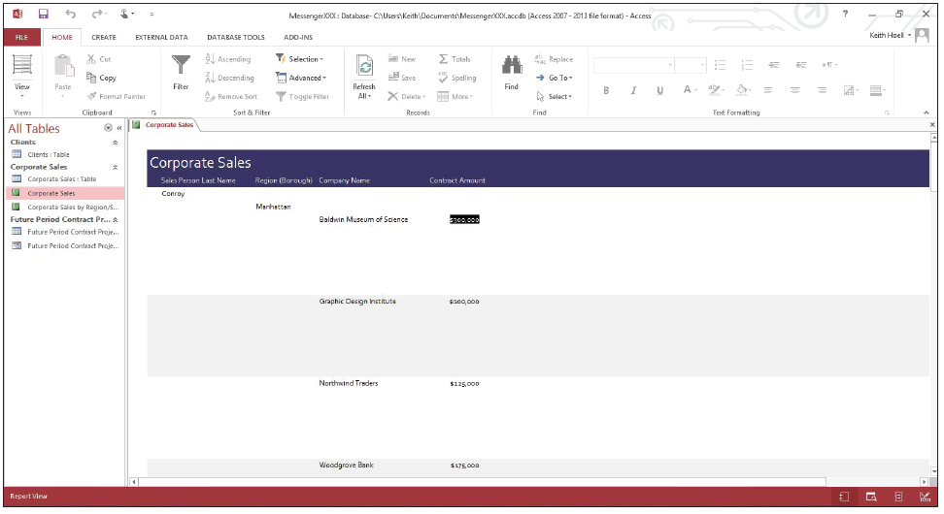
Step by Step: Change Grouping Options
Switch to Report view to see the report. Your screen should resemble Figure 11-12.
SAVE the report.
PAUSE. LEAVE the database open to use in the next exercise.

Slide 22
Step by Step: Create Aggregate Fields
USE the database and report that is open from the previous exercise.
Switch to Layout view.
Click the Group On Sales Person Last Name row and click More.
Notes:
Another Way: You can also right-click a field in Layout view and select Total from the shortcut menu to apply an aggregate function to a field.

Slide 23
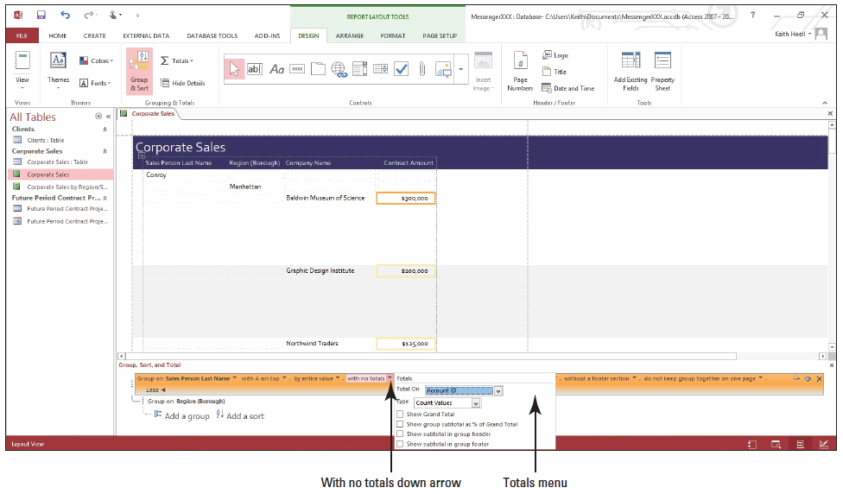
Step by Step: Create Aggregate Fields
Click the with no totals down arrow. The Totals menu appears, as shown below.

Slide 24
Step by Step: Create Aggregate Fields
Click the Total On menu down arrow and select Contract Amount.
Click the Type menu down arrow and select Sum if it isn’t selected already.
Click the Show Grand Total box. The menu disappears and the grand total appears in the Contract Amount column at the bottom of the report.
Click the Group On Sales Person Last Name row again and click More, then click the with Contract Amount totaled down arrow.

Slide 25
Step by Step: Create Aggregate Fields
Click the Total On menu down arrow and select Contract Amount, then click the Show subtotal in group footer box. The settings are applied, and the subtotals are now shown in each group’s footer.
Select the Sales Person Last Name field header on the report.
On the DESIGN tab, in the Grouping & Totals group, click the Totals button and select Count Records from the menu.
Switch to Report view. The total number of records appears at the bottom of the report.
SAVE the report.
PAUSE. LEAVE the database open to use in the next exercise.

Slide 26
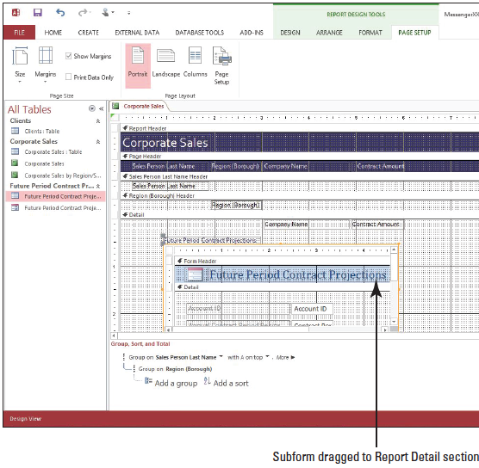
Step by Step: Create a Subform on a Report
USE the database and report that is open from the previous exercise.
Switch to Design view.
Click and drag the Future Period Contract Projections form object from the Navigation Pane to the Report Detail section under the Company Name and Contract Amount controls. Your screen should look similar to te figure at right.

Slide 27
Step by Step: Create a Subform on a Report
Switch to Report View to view the Report and related subform, and cycle through the two records in the top subform using the record navigation buttons on the subform.
SAVE the report and CLOSE it.
PAUSE. LEAVE the database open to use in the next exercise.

Slide 28
Step by Step: Create the Print Layout
USE the database that is open from the previous exercise.
Right-click the Corporate Sales report in the Navigation Pane and select Copy from the shortcut menu that appears.
Right-click in a blank area in the Navigation Pane and select Paste from the menu. The Paste As dialog box appears.
In the Paste As dialog box, replace the name of the report in the Report Name field by keying Sales by Salesperson and clicking OK.
Open the Sales by Salesperson report in Design view. You want to remove the subform from the report and keep only the sales related to each salesperson.

Slide 29
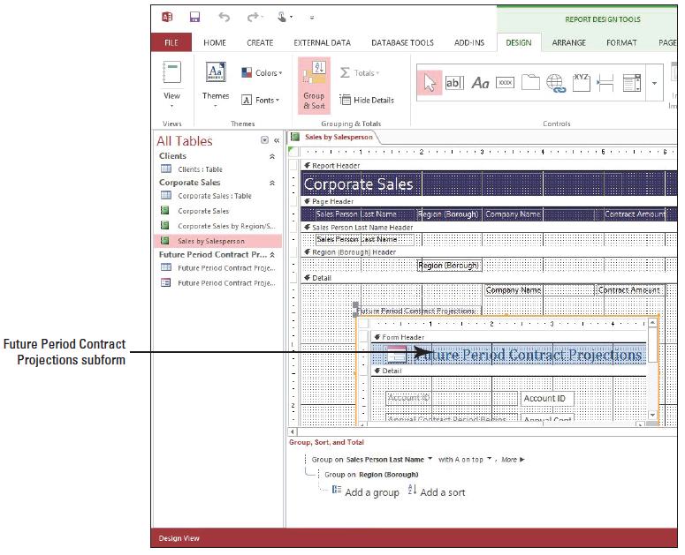
Step by Step: Create the Print Layout
In the Detail section, click the Future Period Contract Projections subform as shown at right. [Press Delete] on the keyboard to delete the subform.
Notes:
Take Note: Throughout this lesson you will see information that appears in black text within brackets, such as [Press Enter], or [your e-mail address]. The information contained in the brackets is intended to be directions for you rather than something you actually type word-for-word. It will instruct you to perform an action or substitute text. Do not type the actual text that appears within brackets.

Slide 30
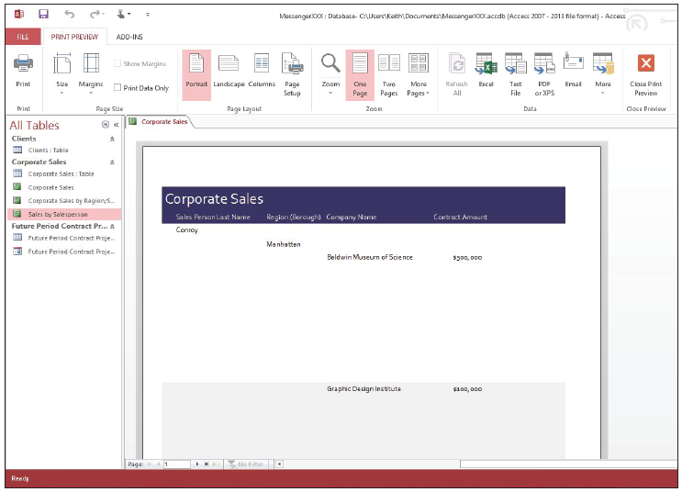
Step by Step: Create the Print Layout
On the HOME tab, in the Views group, click the lower half of the View button and select Print Preview from the menu. The report is displayed in Print Preview, as shown at right. Notice the large area of blank space between company names in the detail section.

Slide 31
Step by Step: Create the Print Layout
On the PRINT PREVIEW tab, in the Zoom group, click the Two Pages button. The first two pages of the report are displayed on the screen. Notice the second page has no report data on it. You need to correct these issues in Report Design view to ensure the report print layout is appropriate before printing.
On the PRINT PREVIEW tab, click the Close Print Preview button to return to Report Design view.

Slide 32
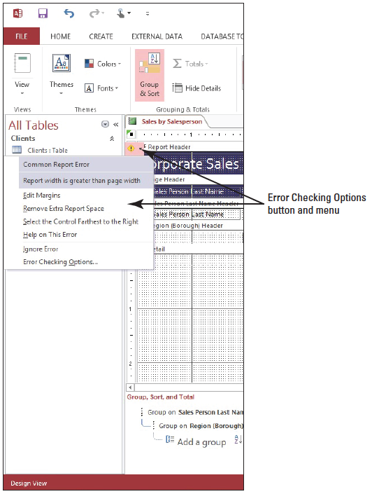
Step by Step: Create the Print Layout
Click the Error Checking Options button next to the Report Header section title to view the Error Checking Options menu, as shown at right. Notice the menu text that states Report width is greater than page width. Click the Remove Extra Report Space menu option. The report’s width is automatically adjusted; however, the issue is not entirely corrected and the Error Checking Option button still appears.

Slide 33
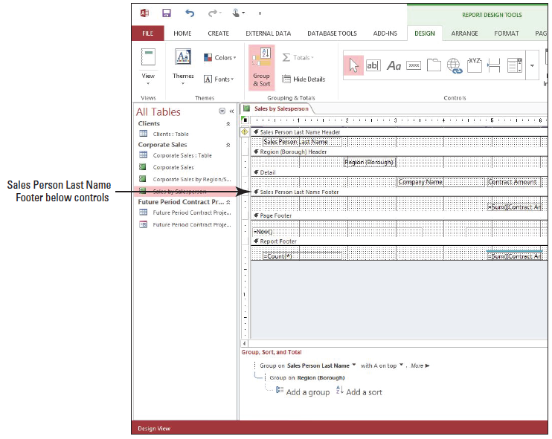
Step by Step: Create the Print Layout
Scroll to the bottom of the report, if necessary, and place the pointer over the top of the Sales Person Last Name footer until it turns into a two-headed vertical pointer. Click and drag the Sales Person Last Name Footer and place it below the Company Name and Contract Amount controls, as shown at right. This removes the excess blank space between company names in the Detail section.
Notes:
Another Way: You can also move and/or resize the page numbering control in the Page Footer section in Report Design view to ensure it appears within the page margin width. This is one of many different ways to create a viable print layout depending on your page size.

Slide 34
Step by Step: Create the Print Layout
Switch to Print Preview. Notice the report layout still appears on two pages. The Remove Extra Report Space didn’t entirely fix the issue. The page number control is exceeding the width of the page in Design view as evident by the page numbering text appearing in the footer section of the second page. On the PRINT PREVIEW tab, in the Page Layout group, click the Landscape button. The report is displayed in landscape orientation and the formatting appears correctly.
On the PRINT PREVIEW tab, in the Page Layout group, click the Portrait button. The report is displayed in portrait orientation again.

Slide 35
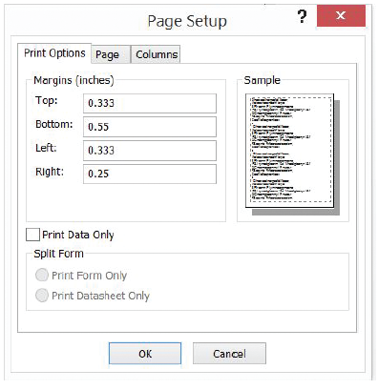
Step by Step: Create the Print Layout
On the PRINT PREVIEW tab, in the Page Layout group, click the Page Setup button. The Page Setup dialog box appears, as shown at right. Notice it contains many of the same options that are available in the Page Layout group but also includes additional options and details that can be modified.

Slide 36
Step by Step: Create the Print Layout
Click the Page tab. Click the Size box down arrow and select Tabloid from the menu to see if all data will fit on one page.
Click OK. Notice that all the report data fits on one page.
On the PRINT PREVIEW tab, in the Zoom group, click the Zoom button arrow and select 50% from the menu. Notice that you have to scroll to view all the data.
Click the Close Print Preview button on the PRINT PREVIEW tab. You are back in Design view.
Notes:
Take Note: You may also use the Page Setup dialog box to change the left margin size to match the right margin size to prevent the layout from appearing on two pages. This will cause your report data to appear on two pages.

Slide 37
Step by Step: Create the Print Layout
SAVE the report design and switch back to Print Preview.
On the PRINT PREVIEW tab, click the Print button. The Print dialog box appears. Click OK to print or click Cancel to close the dialog box.
CLOSE Print Preview and the report.
PAUSE. LEAVE the database open to use in the next exercise.
Notes:
Another Way: Right-click the report you want to preview in the Navigation Pane and select Print Preview from the shortcut menu.
Take Note: You can add the Print Preview and/or the Quick Print command to the Quick Access Toolbar by clicking the Customize Quick Access Toolbar down arrow at the end of the toolbar and selecting Print Preview or Quick Print from the menu.

Slide 38
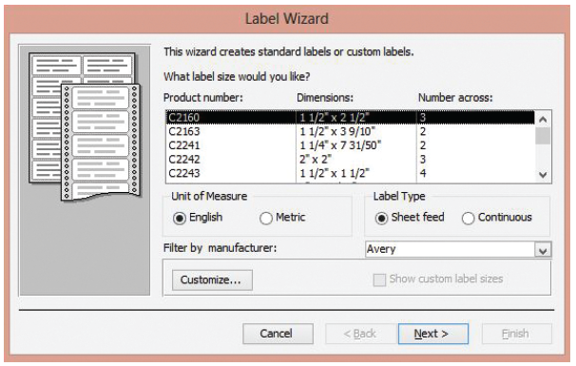
Step by Step: Use the Label Wizard
USE the database that is open from the previous exercise.
Select the Clients table in the Navigation Pane.
On the CREATE tab, in the Reports group, click the Labels button. The first Label Wizard dialog box appears, as shown at right.

Slide 39
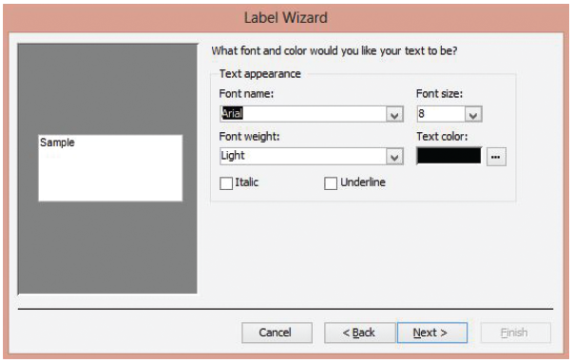
Step by Step: Use the Label Wizard
Scroll down in the Product Number box and select Avery USA 5160 and click the Next > button. The second Label Wizard dialog box appears, as shown at right.
Notes:
Another Way: Instead of scrolling through a menu of options, you can simply start typing the first few characters of the option you want to choose to have it automatically appear.

Slide 40
Step by Step: Use the Label Wizard
Click the Font name: down arrow and scroll down to select Times New Roman. Notice the preview sample displays the new font.
Click the Font size: down arrow and select 9.
Click the Font weight: down arrow and select Normal.
In the Text color section, click the Ellipses button to display the Color dialog box. Notice the options available, then click Cancel to close it.

Slide 41
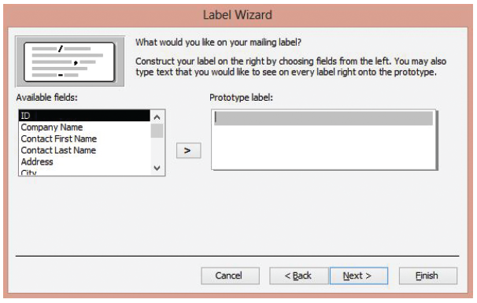
Step by Step: Use the Label Wizard
Click the Next > button. The third Label Wizard dialog box appears, as shown at right.
Select the Company Name field in the Available Fields list and click the > button to place it on the Prototype label.
Notes:
Another Way: You can also double-click each field name in the Available Fields list to place it on the Prototype label.

Slide 42
Step by Step: Use the Label Wizard
[Press Enter.]
Key ATTN: and [press the Spacebar].
Select the Contact First Name field and click the . button.
[Press the Spacebar] to insert a blank space between fields.
Select the Contact Last Name field and click the . button.
[Press Enter.]
Select the Address field and click the . button. [Press Enter.]
Select the City field and click the . button. Key a comma and [press the Spacebar].

Slide 43
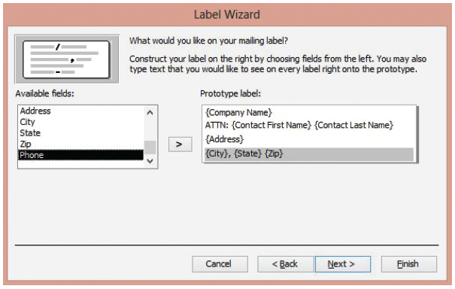
Step by Step: Use the Label Wizard
Select the State field and click the . button. [Press the Spacebar.]
Select the Zip field and click the . button. Your screen should look similar to the figure at right.

Slide 44
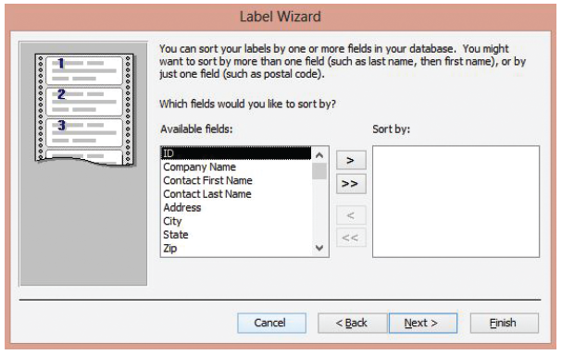
Step by Step: Use the Label Wizard
Click Next >. The fourth Label Wizard dialog box appears, as shown at right.
Select the Zip field and click the > button.

Slide 45
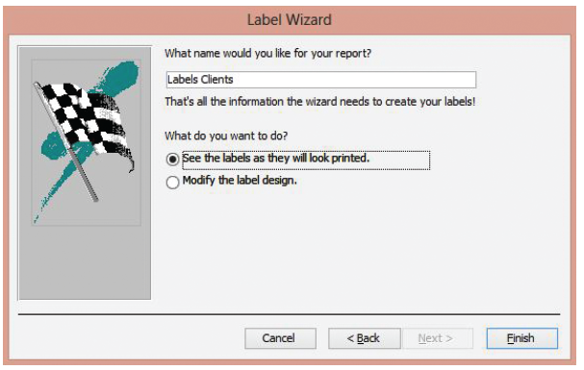
Step by Step: Use the Label Wizard
Click Next >. The fifth Label Wizard dialog box appears, as shown below.

Slide 46
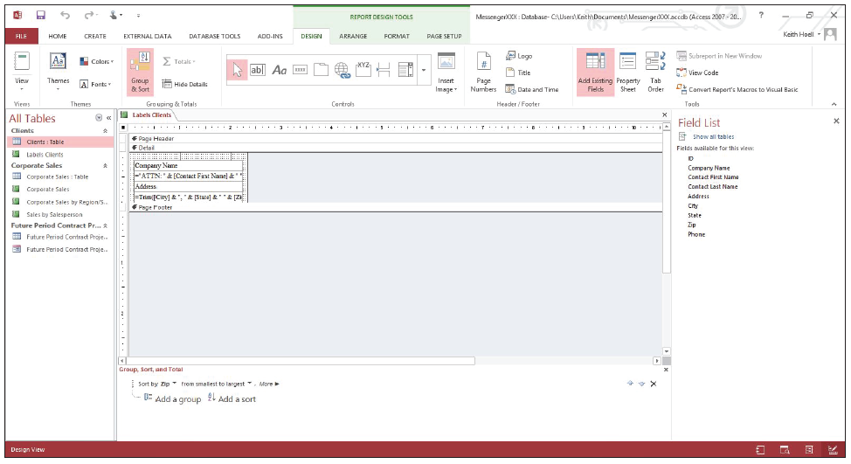
Step by Step: Use the Label Wizard
Click the Modify the label design option button and click Finish. Your screen should look similar to the figure below.

Slide 47
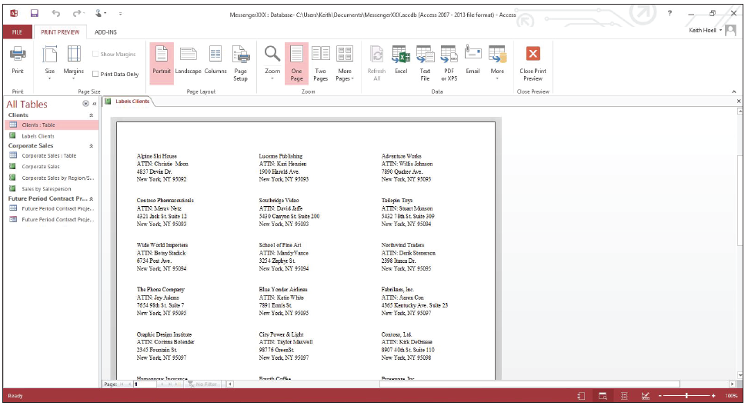
Step by Step: Use the Label Wizard
On the HOME tab, in the Views group, click the lower half of the View button and select Print Preview from the menu. Your screen should look similar to the figure below.

Slide 48
Step by Step: Use the Label Wizard
Click the Print button. The Print dialog box appears. Click OK to print or click Cancel to close the dialog box.
CLOSE Print Preview and the report.
CLOSE the database.
Notes:
Troubleshooting: If Access displays a message warning you that some of your data may not be displayed, this means the controls on the label are too wide for the allotted space. If this happens, try reducing the size of the controls in Design view so that they fit in the space available for a single label or try reducing the page margins using Page Setup.
Take Note: As an alternative to printing labels, you can print addresses directly onto envelopes. To do this, you will need to create a custom label instead of a predefined label and set the Label Type setting to Sheet Feed.

Slide 49
Skill Summary

